Slide 1



Building an effective Prototype using Route Mobile’s APIs - RAPID Hackathon, 2021
Team Name: AR Solutions
Team Member: Aryan Sinha

Slide 2
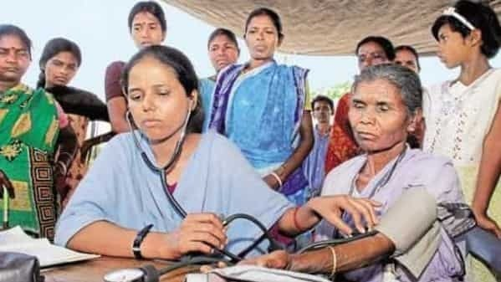

POOR HEALTHCARE SYSTEM
IN RURAL INDIA
1. INSUFFICIENT MEDICAL INFRASTRUCTURE
2. LACK OF BASIC MEDICAL
FACILITIES
3. NO ACCESS TO SPECIALIZED
MEDICAL CARE
ONLY 1/5TH OF THE HOSPITALS ARE IN THE RURAL AREAS FOR 70% OF INDIA’S POPULATION WHICH RESIDES IN RURAL AREAS.
PUBLIC HEALTH CENTERS OF RURAL AREA DO NOT HAVE BASIC FACILITIES SUCH AS X- RAY OR BLOOD TESTING FACILITIES.
RURAL PEOPLE DO NOT HAVE ACCESS TO SPECIALIZED DOCTORS
2

Slide 3
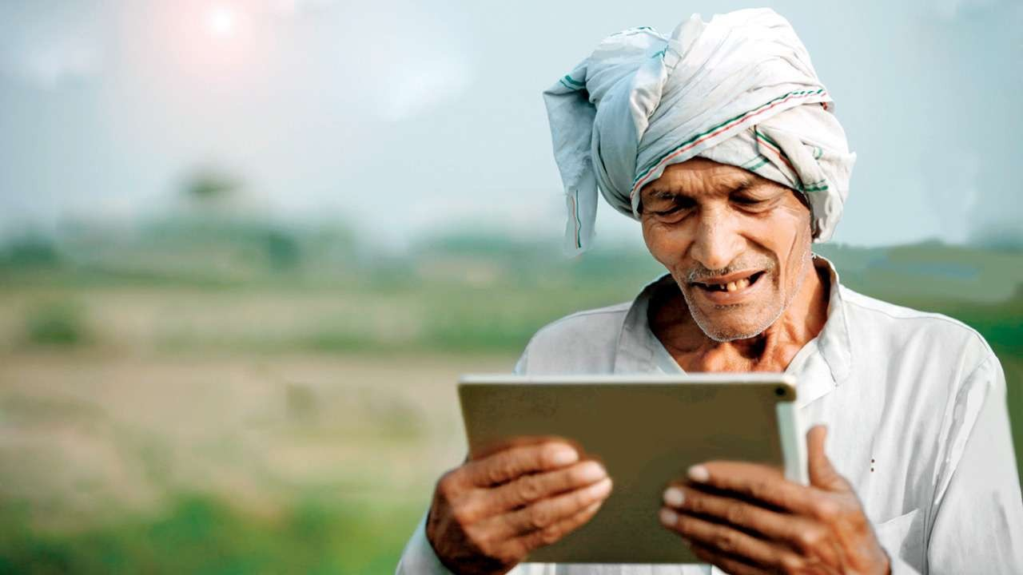



MARKET OPPORTUNITY
MARKET SIZE
Healthcare market in
India is expected to reach USD 193.83 Billion by 2020 and 372 Billion by 2022 which is driven by rising income, better health awareness, lifestyle diseases and increasing access to insurance.
STRONG DEMAND
India is a country where 65% of the total population lives in the Rural parts from which majority are denied access to healthcare. Mostly this arises due to lack of accessibility to healthcare in these areas.
RISING MANPOWER
Availability of large pool of well-trained medical professionals in the country. The number of registered doctors with recognized medical qualifications under medical council of India have increased from 8,27,000 in 2015
to 12,55,786 2021.
8/13/21 5

Slide 4

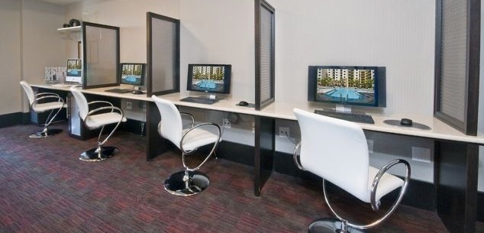
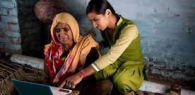
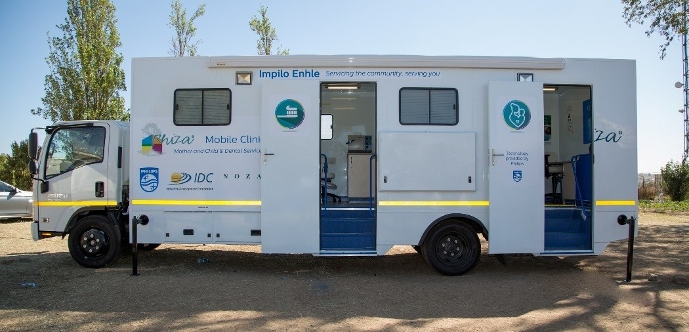
TARGET CUSTOMERS
Main Occupations of people in Rural India include Agriculture, Dairy Activities, Teaching and Small Businesses.
Target Customers based on Occupation:
Large Farmers
Medium Farmers
Small Business Owners
Teachers
Dairy Activity
Target Customers based on Economics:
Old Aged Parents
Children
Pregnant Women
Middle Class Man
Uninsured Families and People
Winning edges of Medicus will be:
Trust
Language
Strong and Lasting Relationships with the Customers and Doctors

Slide 5
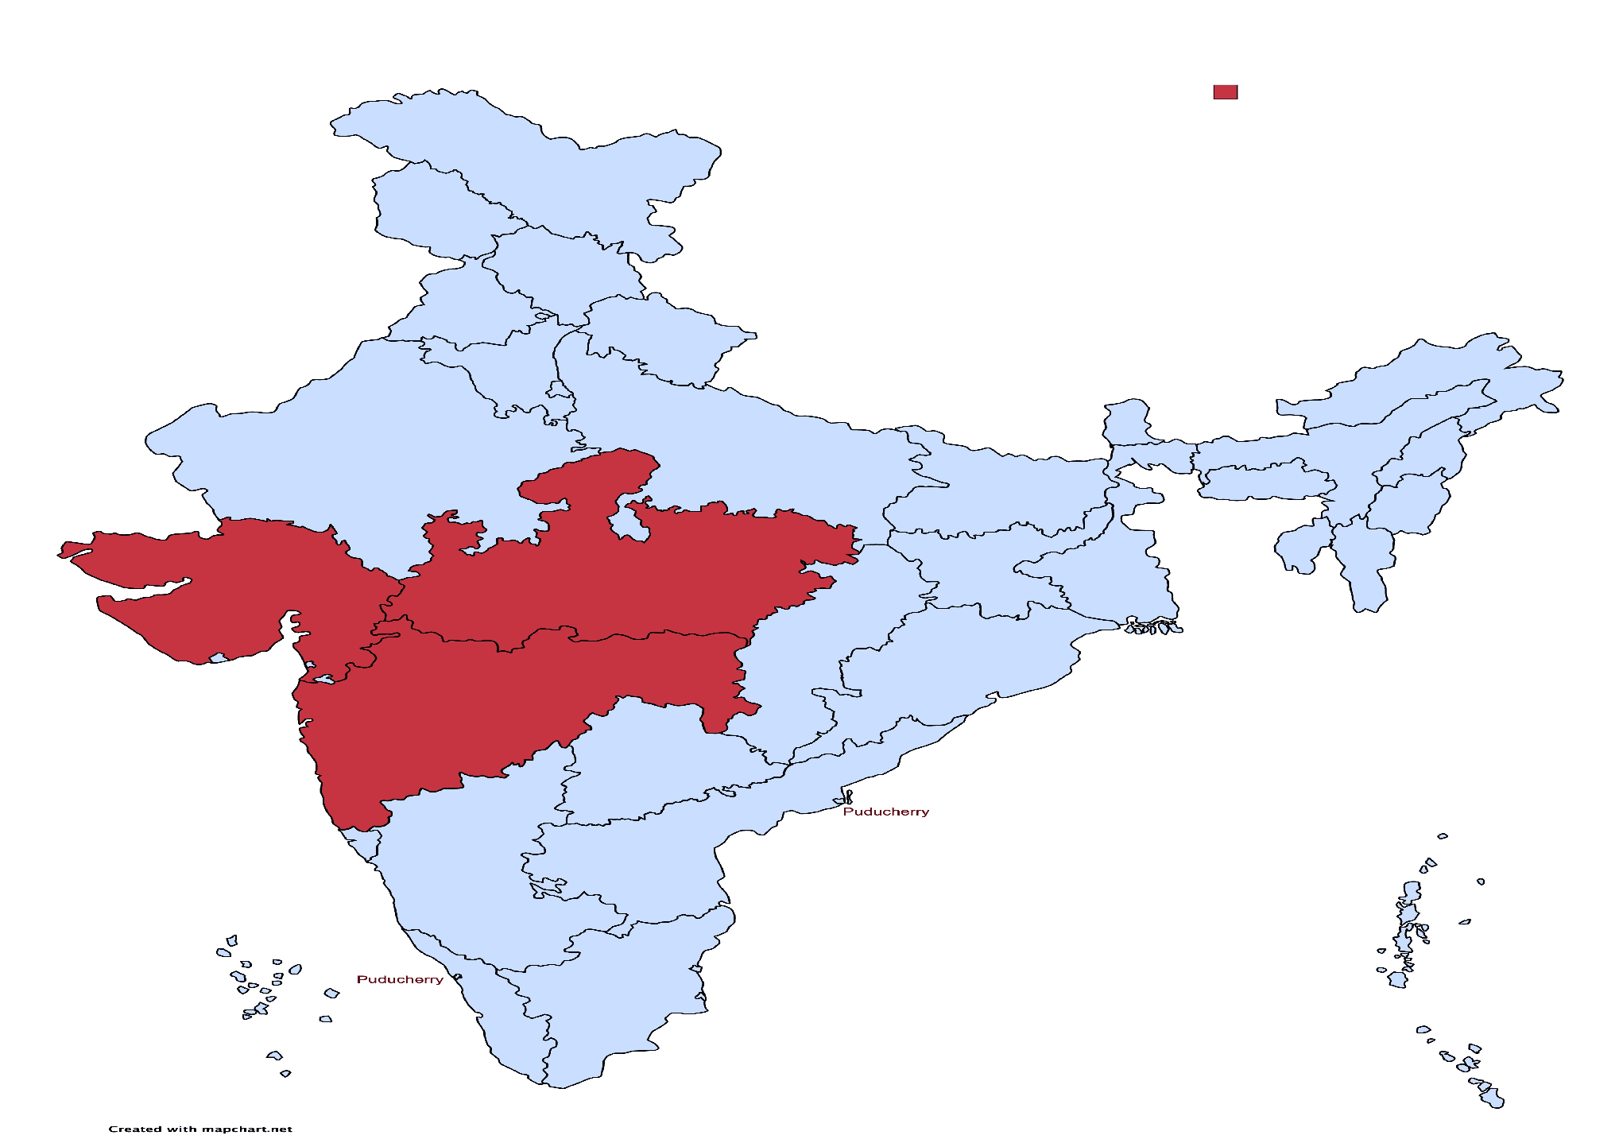





GO TO MARKET STRATEGY AND TIMELINE
DECEMBER 2021
FEBRUARY 2022
SEPTEMBER 2022
Multiply users & monitor growth. Understand the Market.
Mobile Application Launch.
First Omnichannel Model Clinic Launch.
Launch of mobile labs and digital diagnostic services.
MARCH 2022
Expansion of Medicus to other Rural Areas and Villages
DECEMBER 2022
Launch of Marketing Campaigns and Events.
JANUARY 2022

Slide 6
UNIQUE ADVANTAGES
ONE STOP SERVICE FOR ALL HEALTHCARE NEEDS OF THE USER.
UNIQUE BUSINESS MODEL.
FAST CUSTOMER REACH APPROACH.
AIM TO BUILD AND CONNECT WITH USERS AND DOCTORS WITH TRUST AND FAITH.
LEVERAGE NEW GOVERNMENT SCHEMES LIKE RURAL ENTREPRENEUR, SVEP AND ATAL INNOVATION SCHEME.
BUILD A PASSIONATE AND MOTIVATED TEAM.

Slide 7
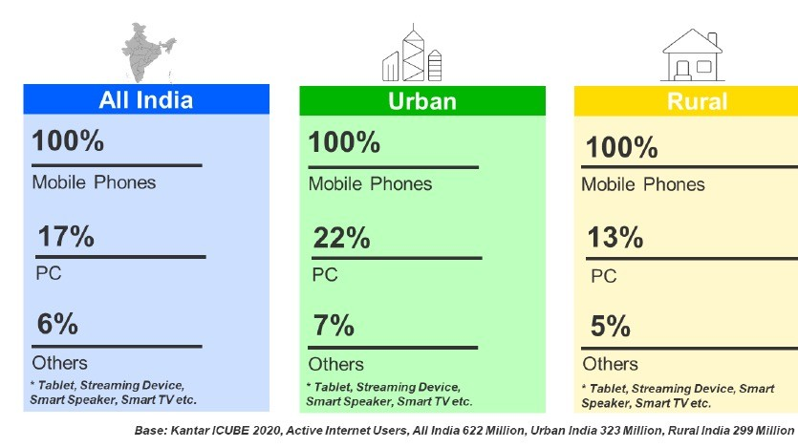
WHY NOW?
Population of 900 Million people constitute Rural India.
By 2025, Rural India will likely have more internet users than Urban India
With the success and emergence of Agritech start-ups in Rural India, we believe India is ready for Healthcare start-ups.
Various schemes and support from Government of India for Rural Start-ups.
No clear market leader in the Rural Healthcare Segment. Unexplored Market Space.
The Healthcare Market in India will be estimated at 400 Billion USD by the year 2024. India is planning to increase public health spending to 2.5% of the country's GDP by 2025.

Slide 8
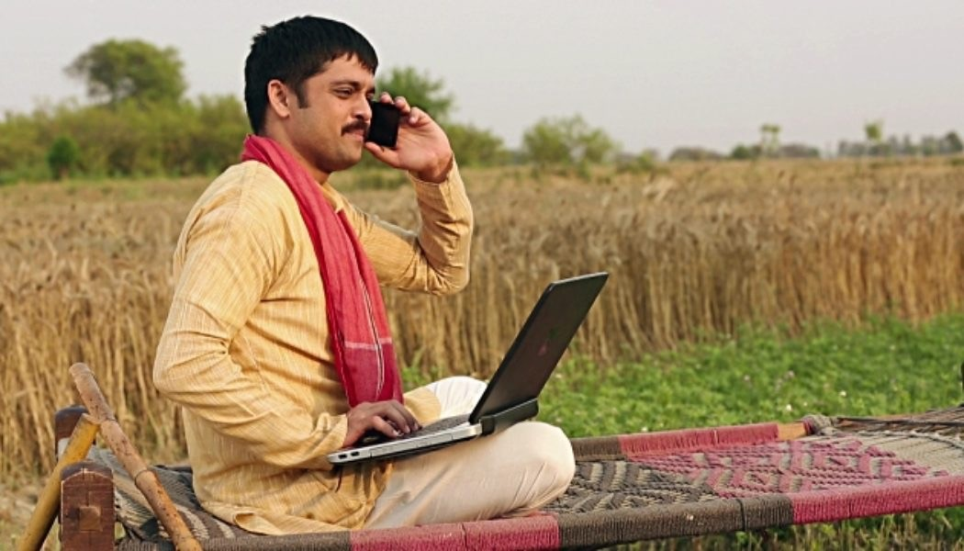
PROJECTED GROWTH PLAN
Research on the Market
Development of MVP
Register Users
Register Doctors and Clinics
Decide on Features to be added
Shortlisted Areas for Business
Business Expense Model
Develop the Omnichannel Model
Train the people in using the services
Generate Revenue
Expansion of Business to other states
8/13/21 17

Slide 9

“Get the care you need, and the compassion you deserve.”

Slide 10
TECHNICALSLIDES

Slide 11
THE PROBLEM
2020 was a year of awakening to the entire world. We were made realize of the fact that the medical infrastructure we as a country have is nowhere in proportion to the exponential increase in population each year. Such a problem can be solved by the rightful use of technologies such as Artificial Intelligence, Internet of things and Deep Learning.
In the hard count now during 2021, 1.33 billion of Indian population is being served by 1.8 million registered medical graduates. So, the ratio is 1.34 doctor for 1,000 Indian citizens as of 2021.
According to a report, there is 83% shortfall of physicians, 76% for obstetricians and gynaecologists, 82% for paediatricians and 83% for surgeons in community health centres in India.
With today’s rise in population the demand for efficient and experienced health care professionals this model revolves around mainly bringing Patients, Doctors, Caretaker staff and Hospitals on one common platform so that they can come in contact with each other on a digital platform and solve any problem they face in a shorter span of time.
We believe if we can use the technologies at our disposal to ensure proper Time Management and efficiency for the health care sector then we can expect better results.

Slide 12
PROPOSED SOLUTION
The basic approach to the idea will be to create a Mobile App and a Web Responsive application where there is a wide range of features made available revolving around IOT,AI and Deep Learning so that the user can automate easy to do tasks which are discussed further.
These solutions will help surgeons, patients and care teams throughout the patient journey by automating some of the crucial tasks done manually such as decision making, post-surgery planning, tracking and estimating recovery-time, and takes patients' feedback.
The three challenges surrounding improvement in HealthCare system in India: Accessibility, Availability and Affordability and our solution aims at addressing these issues with the use of technology.
The approach to the solution will be to create a Smart Medicial Assistant Service accessible using a Mobile App and a Website which will serve as a bridge between the consumer and service provider.
Through this the user can get an Expert Medical Consultation and other Medical Services such as Diagnostic Services, Smart Healthcare Solutions, Emergency Care and an E-Commerce Medicine Delivery System.

Slide 13
TECHNOLOGY STACK
Frontend
Backend
Meta
HTML
Microsoft Azure Cloud
Python 3.8
Wordpress/Go daddy Hosting
MySQL Workbench
HTML
API
Requests
Android Studio
IBM Cloud Services
JSON
IBM Watson Services
Self Assembled Datasets
JAVA
*For more information about the technology stack please view the pdf titled Stack in the Tech stack folder.

Slide 14
Web Application/Mobile App
Homepage
Patients Portal
Doctors Portal
Smart Doctor
Emergency Care
Feedback
Login Page
Login Page
An AI enabled chatbot
Powered by an AI Chatbot this webpage aims to immediately call for an emergency procedures along with calling for an ambulance this webpage will also be able to inform the hospital to prepare for the OT
Record feedback of the user
User Dashboard
Doctor Dashboard
This chatbot will be able to Predict a patient's prescription based on his/her symptoms
Medical History
Schedule/Cancel Appointments
Register Complaints by User
Bill Payment
Complete Database of all
the Patients
Book an appointment
Customized patient
Medical Procedures tracking
Online consultation to patients via video call/chat
Track patient recovery
Connect to Doctor
*All webpages are chatbot enabled to provide a user-friendly experience

Slide 15
FUTURE PROSPECTS
There are some features which we planned to add but due to the hard time constraint were unable to integrate during the deadline.
There is a plan to enable a voice agent customer using Text to Speech chatbot using which will be helping the specially abled users to make it easier for them to use the website and mobile app, also have started working on IBM Watson Studio - Deep Learning as well as StreamLit and Django for the deep learning prediction models for selected disease detection. Brain Tumor, Covid-19 Detection and Pancreatic tumor segementation are decided by the end of 2021.
The Medicus chatbot needs to be more trained and able to diagnose a wider range of diseases. We plan on consulting a few specialized Doctors who will be able to help us make Medicus the chatbot predict more diseases and increase accuracy.
For the prototype phase we have stressed on making this model hospital specific but we plan on making it offer a wider range of medical services to a range of hospitals.
Another key feature we had thought of integrating was a combination of AI and IOT tools which involved a highly accurate tracking system which would help the hospital track an ambulance or an organ which has to transplanted. This accurate tracking will allow the hospital to get the operation theatre or the emergency room ready as soon as the asset comes closer. This device uses RF tracking feature.

Slide 16
FUTURE WORKFLOW AS
PLANNED
Web Application/Mobile App
MEDICUS
Patients Portal
Doctors Portal
IOT Services
Affordable
Medical
Insurance
Smart
Medicine
Delivery
System
Login Page
Login Page
AI enabled chatbot
Voice Over Alexa Skill
AI Model
User Dashboard
Doctor Dashboard
IOT and E-commerce
Model
Medical History
Schedule/Cancel Appointments
This chatbot will be able to Predict a patient's prescription based on his/her symptoms
An Alexa Skill will be deployed linked to the mobile application which will provide the user with timely remainders of his/her medicines and appointment and will also help in the diagnosis of disease and provide an accurate prescription
Majority of the
population living in
the India do not
avail medical
insurance. We will
create a platform
which will easily be
able to provide an
easy and affordable
medical insurance to
Dashboard for surgery the user.
Bill Payment
This service is focused
on the pharmacies
and people from
remote villages and other parts of India.
Basically, it is how we
will connect with local
pharmacies and
deliver them high
quality medicines on
time and on fixed
price.
Database of all the
Patients
Book an appointment
Online consultation to patients via video call
Smart Medical report generator using AI
Smart X-ray Scanner
Track patient recovery
by regular updates
Connect to Doctor via
Video call/chat
Dashboard for surgery
planning.

Slide 17

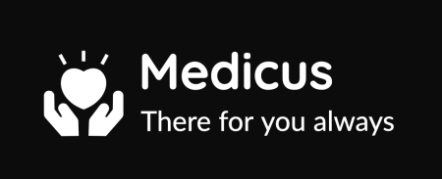
Thank You
Hope you like the presentation
""There is no Idea in the world that cannot be improved"". I would again like to stress on the fact that there is always room for improvement in the project.

